Slide 1
Adapting Project Productivity to a Different World of Competition
Harry Benham
AVEVA Catalyst for Change: New Orleans, Oct 2016
Notes:
xxxx

Slide 2
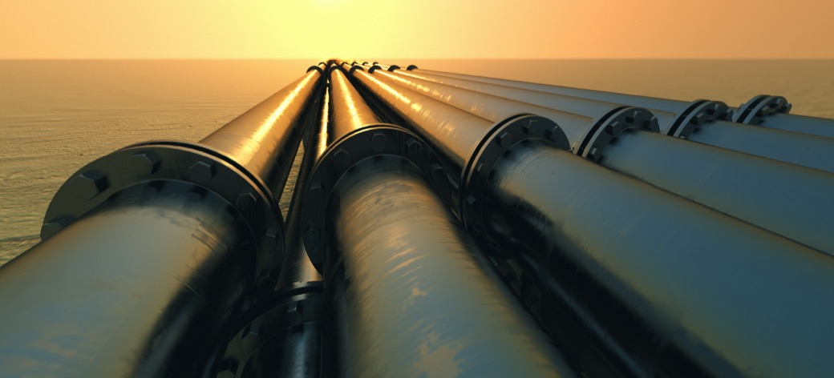
AGENDA
The legacy of the last 15 years of high energy prices has been a slump in project productivity and major increase in all project costs
Increasing energy competition will maintain pricing pressure - project performance will need to deal with lower levels of capex
Radical transformation is required in project management for oil and gas delivery to become more efficient and productive for the next era
Leadership required in portfolio screening, revamp of the engineering model, plainer contracts and aggressive uptake of professional planning and management tools

Slide 3
FIVE KEY ACTIONS FOR PRODUCTIVITY
STRATEGIC SHIFT FROM SCARCITY TO COMPETITION
… portfolio shift from volume to efficiency, from large single asset, to scalable, flexible units
CHANGE
ENGINEERING MODEL
… limit in-house design resource – rely more on market expertise and standard designs
SIMPLIFIED CONTRACTS AND PROCUREMENT
… avoid managing complexity with complex contracts. Simpler templates and scopes, clearer obligations
INVEST IN PROFESSIONAL SYSTEMS AND PLANNING TOOLS
… avoid ad hoc, in-house, improvised or generic processes
AVOID CONSTRUCTION COMPLEXITY VIA DESIGN
… increase modular, dedicated yards, standards designs and layout
Notes:
Q: The subject that we are highlighting in today’s webinar is that the strategy of deploying megaprojects to chase volume growth is unsustainable as it has resulted in commercial failure even in a high price oil market. Tell me why you have come to this conclusion

Slide 4
FIVE KEY ACTIONS FOR PRODUCTIVITY
STRATEGIC SHIFT FROM SCARCITY TO COMPETITION
… portfolio shift from volume to efficiency, from large single asset, to scalable, flexible units
CHANGE
ENGINEERING MODEL
… limit in-house design resource – rely more on market expertise and standard designs
SIMPLIFIED CONTRACTS AND PROCUREMENT
… avoid managing complexity with complex contracts. Simpler templates and scopes, clearer obligations
INVEST IN PROFESSIONAL SYSTEMS AND PLANNING TOOLS
… avoid ad hoc, in-house, improvised or generic processes
AVOID CONSTRUCTION COMPLEXITY VIA DESIGN
… increase modular, dedicated yards, standards designs and layout
Notes:
Q: The subject that we are highlighting in today’s webinar is that the strategy of deploying megaprojects to chase volume growth is unsustainable as it has resulted in commercial failure even in a high price oil market. Tell me why you have come to this conclusion

Slide 5
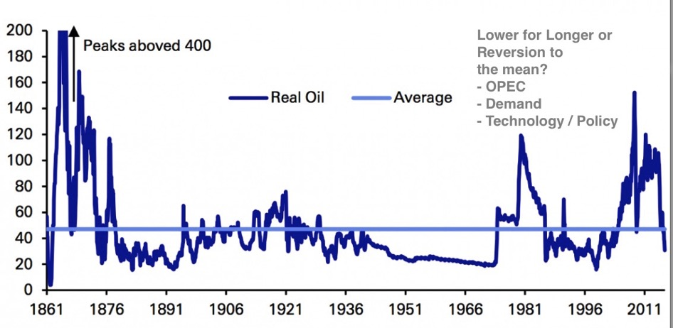
PARADIGMS VS MATHS Real Oil Price 1861-2015

Slide 6
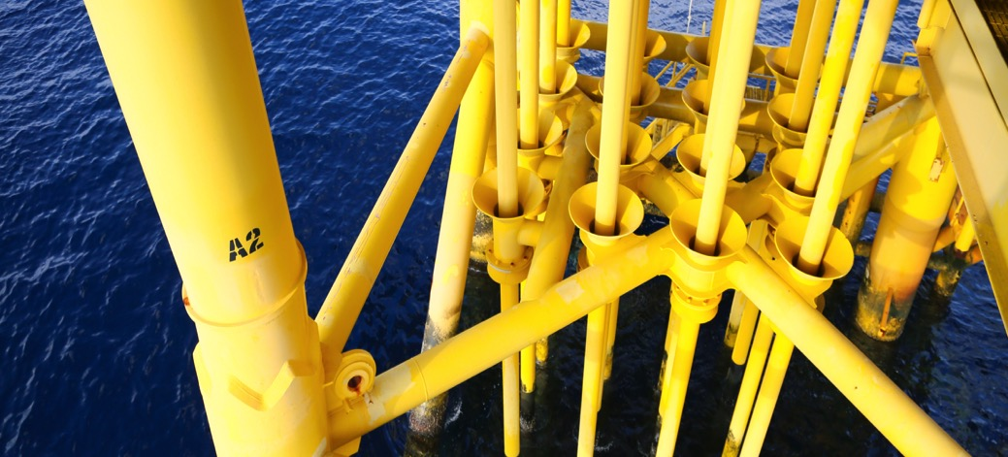
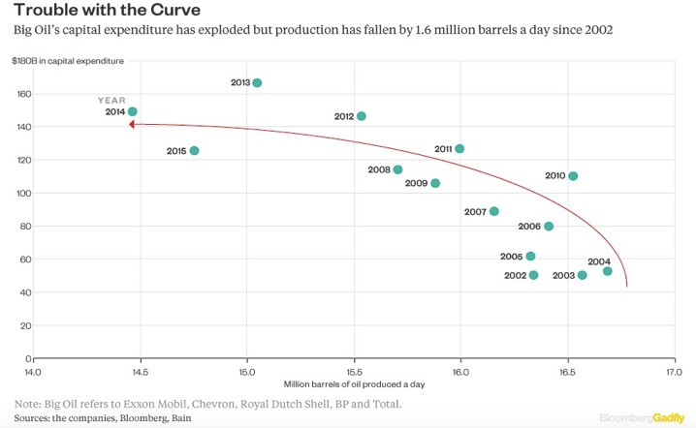
EXTRACTION VS MANUFACTURING
Contrast IOC Production with US LTO
 | Top 8 IOCs | US Shale
Investment 2004-14 (Trillon USD) | 1.5 | 0.35
Production Increase – mbpd | -1.5 | 4.5

Slide 7
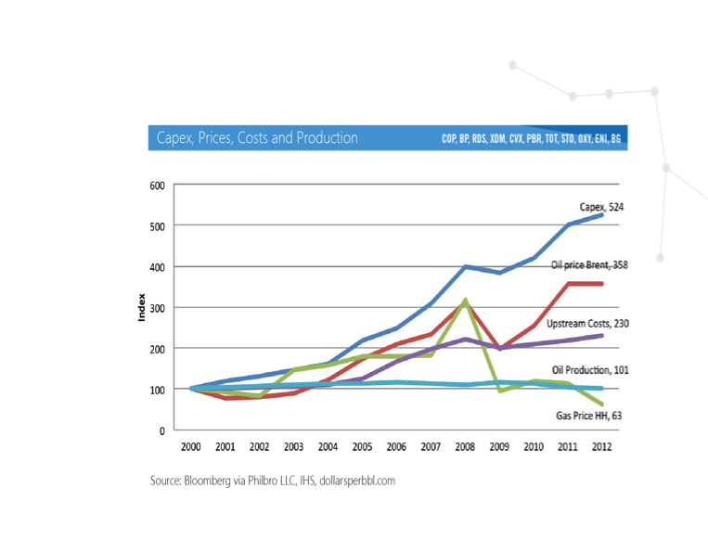
ENERGY MEGAPROJECTS
Least Productive Industry in the past 15 years?
Productivity down x5
Return on Capital down x3
Negative free cash-flow
Production flat / RRR negative
Break-even at $65-80/bbl
$500bn Marginal Project Cancellations
Plus Potentially $250bn of further capex based on performance

Slide 8
BIG IS FRAGILE
Complex is very different to Complicated
Prof Bent Flyvbjerg
Major Programme Management
Oxford University Said Business School
“..the theories of big on efficiency and building capacity ahead of demand encourages managers to take “definitive static bets” on big ventures.
What theories of big fail to incorporate in their logic is that oversizing a system increases its complexity disproportionately,. And this leads to fragility.
Despite their Goliath appearance, big capital investments break easily – deliver negative net present value – when faced with disturbances. A greater propensity to fragility is intrinsic to big investments.”
Iron Law of Megaprojects
“Over time, over budget, over and over again”.
Over 90% failure rate
Average over-run 50%
Average schedule delay over 2 years
Fat tails - 20% of projects over-run by 100-200 %
Failure rate remains constant over decades in all infrastructure and energy industries
Inherent / systemic risk
“Megaprojects are more ubiquitous and bigger than ever. Contrary to the conventional proposition of bigger is better, we found big capital investments to have a propensity to fragility.”
“Fragility arises when big is forced into doing what was best left to scalable.”
*www.arxiv.org: arXiv:1603.01416
Big is Fragile, An Attempt at Theorizing Scale, Ansar, Flyvbjerg et al
Notes:
Q: Why has this outcome come about- what do you see as the key causal factors?

Slide 9
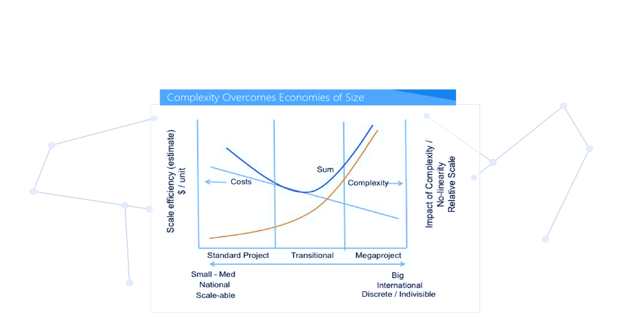
NEGATIVE LEARNING CURVES Complexity Overcomes Economies of Size
Negative Learning Curves
LNG Plants ($/mt)
2004: $500–700
2014: $1,500–3,000
Mega-projects are highly complex one-offs, and demand very experienced teams to manage their unique difficulties. These intrinsic characteristics prevent conventional manufacturing mechanisms of cost improvements such as standardization at a distance and trial-and-error advances that lead to rapid sustainable technical learning and cost reductions.
https://www.bloomberg.com/gadfly/articles/2016-08-29/big-oil-loses-love-for-big-projects

Slide 10
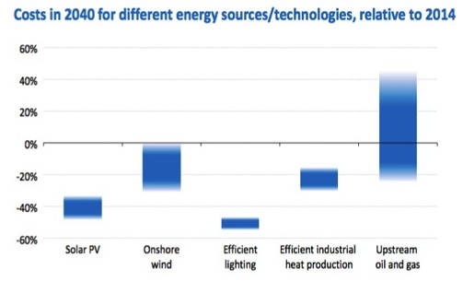
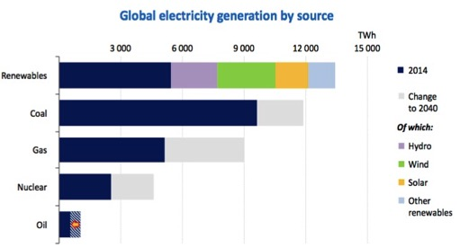
PRODUCTIVITY & ENERGY COMPETITION
Technology, Costs and Policy will determine the 2040 landscape
Oil – focused on transport sector
Gas – “residual” between coal and promoted renewables
Source – IEA WEO 2015, Nov 2015
Even though some of the policies identified in many scenarios have not been deployed, they have in fact been better predictors of demand and consumption
Carbon Tracker, July 2016
Notes:
Q: Why has this outcome come about- what do you see as the key causal factors?

Slide 11
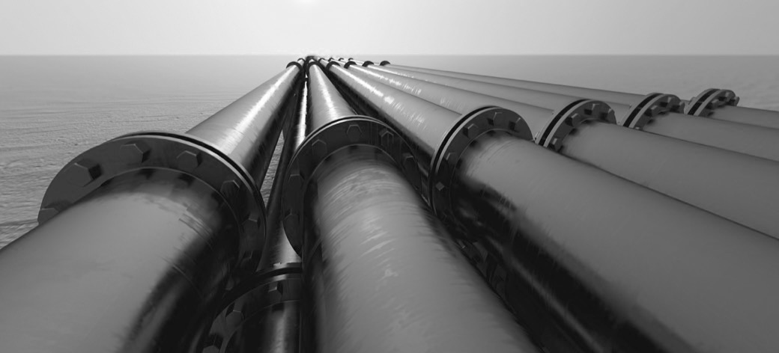
OIL DEMAND – RUNNING OUT OF ROAD?
70% Oil demand from Transportation
mbpd
Technology & Policy Feedback Loops
Macro GDP reduction – population urbanising and aging
Driving patterns- VMT (cf USA)
SE Asia Urban transport planning policies – HSE / Congestion/ Network scale
Energy efficiency – l/100km / ratio of new / second-hand / jet fuel
Emission / clean-air policy
COP 21
Autonomous Vehicles
EV penetration
Plastics recycling
0.9% CAGR
- 15 mbpd
0.5% CAGR
-0.2% CAGR
Source: BP, McKinsey, Carbury Consulting

Slide 12
OIL DEMAND The Basic Equation
Financial
GDP
Population
Car Ownership
Car Use
Financial - IIGCC / Green Bonds
Social – Carbon Tracker / Car Ownership
Regulatory – Emissions Standards / COP21
Technology – EV / Grid / Autonomous
Networks - Policy Forums / Social Media
NETWORKS
Technology
Oil Demand
Social
Transport Demand
2016
50mbpd
Gasoline
Diesel
Jet Fuel
Regulatory
Transport Demand
202X
< 50 mbpd
The Trend In Between ?
*http://www.dollarsperbbl.com/2016/10/05/plan-b-the-unwalled-garden/

Slide 13
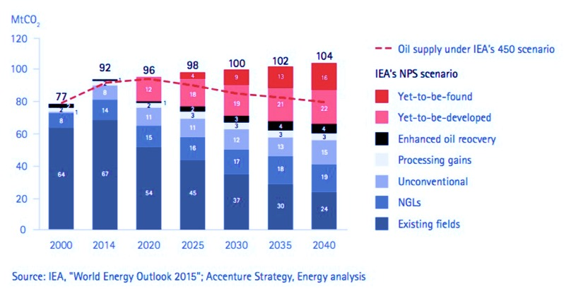
THE END OF EXPLORATION?
IEA Future Supply-Demand Scenarios
mbpd
Oil demand IEA 450 scenario

Slide 14
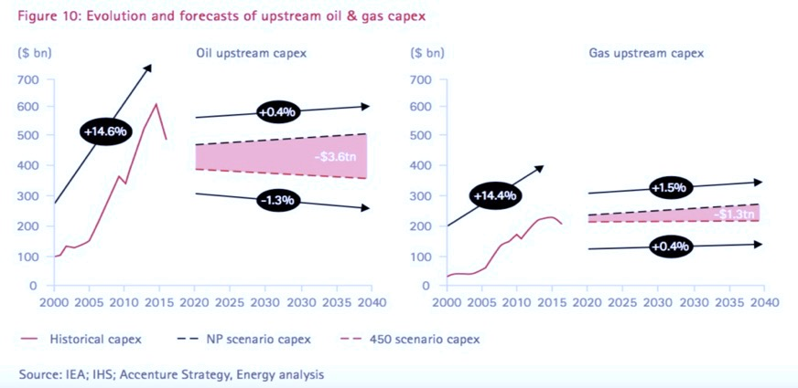
LESS CAPEX Future Investment Scenarios
Previous capex trajectory 2000-14 at 15% pa growth
IEA high growth scenarios to 2040 imply capex growth of 1% pa

Slide 15
FUTURE INVESTMENT STRATEGIES CAPEX also competes with Debt and Dividends
Strategy / Group | NOC | IOC | IND
Previous Growth Model | Develop / Grow Owned Assets via Self-Managed or IOC Service Projects | Develop / Grow New Infrastructure via Megaprojects | Leverage new shale technology / invest with cheap debt
Current Model | Continue investments | Investment freeze, review portfolios | Investment freeze, review break-even costs
Future Strategy | Extend investments / leverage service sectors / IOCs | Constrain investment / reduce cost base / NOC Service model | Assess break-even options to reinvest
Primary Finance Focus (Capex / Dividends / Debt) | Capex | Dividends | Debt
Data / Information Focus | Production | Cashflow / Economics | Productivity / Efficiency
Supplier opportunities:
Software investment open to all companies cf construction
Data organisation vs collaboration
Integrated Engineering Design
Plant efficiency
Equipment logistics
Yard layouts

Slide 16
LARGE ENERGY PROJECTS Complexity Overcomes Economies of Size
Strategic focus has been for volume growth, requiring huge investments and complex designs in frontier locations
This complexity, rather than input prices, has driven high costs, and very poor financial performance
Large one-off investments inhibit learning, and productivity which has not improved
Attempts to standardise and innovate – limited impact due to size and complexity
High risk strategy for owners and contractors even at very high oil prices
Unlikely the oil and gas sector can sustainably “rebalance” to allow such scale and surge in capex growth to happen again given performance history
Needs major change in the way to manage future projects – from full reliance on giant infra-structure build to greater project and operational efficiency

Slide 17
MEGAPROJECT COST OVERVIEW The $80-120/bbl Legacy Model
CONTEXT - IPA Best Practice Model*
Aligned Stakeholders
Robust Business Case
Integrated Owner Team
Front-end design
Experienced Suppliers
Appropriate Contracting Strategies
- Most projects have key gaps
Limited owner teams stretched across multiple locations and complex projects with ad hoc systems – growth in cost and re-engineering
Other Costs
Owner’s Team
* E Merrow, Industrial Megaprojects, 2011
Engineering Services
Third party specialist engineering input – increasingly managed by Owner Teams
Construction
& Fabrication Costs inc Over-runs
Procured Equipment
Design customisation drives price increases, complex requirements
One-off, major scopes with many design changes hamper learning and lead to huge over-runs
>>Clare Colhoun
Notes:
Q: Why has this outcome come about- what do you see as the key causal factors?

Slide 18
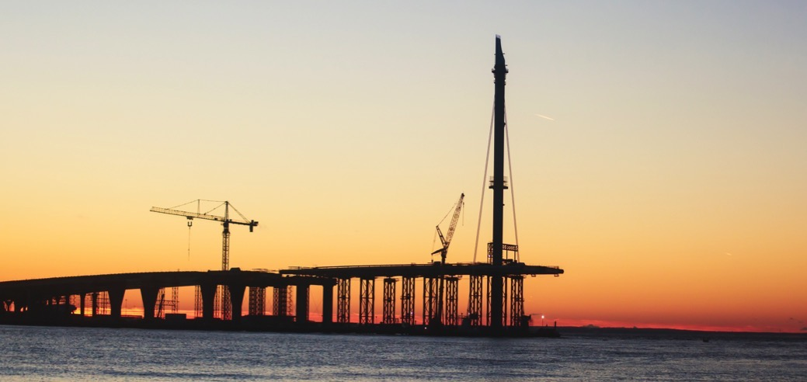
CURRENT ACTIONS Not Addressing the Key Issues
IMMEDIATE TACTICS AND IMPACT
Capex – sharp contraction: future growth of large projects impacted severely
Contractors and Staff – major reductions: skills gaps ahead
Costs with suppliers – renegotiate prices, 10-30% reductions quoted. Analysts suggest this may be maximum available - need structural change.
MEDIUM-TERM SOLUTIONS – VIABLE?
Standardisation – proved difficult for over 30 years, due to one-off nature of most large projects: needs to be designed in more deeply
Innovation – can often be marginal show-cased technical improvements: need project-wide impact
Collaboration – huge complexity and limited time to achieve – design and organisation maybe more effective
Notes:
Q: It’s been a tortuous year for the industry with the landslide in oil prices- what would you say are the key challenges the IOC’s are grappling with aside from the price ?

Slide 19
PORTFOLIO SHIFT A Framework for Cost and Efficiency
PORTFOLIO PHILOSOPHY - BIG IS FRAGILE
SCREENING REALISM:
USE THE OUTSIDE VIEW
SYSTEM CHANGES - BY DESIGN
Change megaproject philosophy from mega-engineering to efficiency: challenge “scale” benefits – the true risk-adjusted value of bigger projects is often low.
Pursue smaller, more flexible, scalable, faster, simpler alternatives: recycle high-risk capital costs into alternate scalable higher-NPV solutions.
Genuinely challenge the Design Selection: avoid alighting on single concept (and variations) quickly, including assumptions on non-technical issues such as JVs and locations.
Pursue smaller, more flexible, scalable, faster, simpler alternatives: recycle high-risk capital costs into alternate scalable higher-NPV solutions.
Introduce more extreme stress tests: 20% of megaprojects are runaways. (>100% over-runs). Runaway scenarios for all projects needed.
Adding padding is no solution: adding 50% contingency solves little – use screening to force redesigns, not inflated estimates
Avoid razor thin margins: investment cases erode over time quickly – all uncertainties add to the right, and sunny assumptions need to be removed. Systemic reductions need a step back.
Pursue standardization at the design level, not by initiatives: don’t be seduced by limited examples of standardisation. Simpler less complex designs are required to solve this deeper problem.
Don’t put all the effort into second order cost issues: supplier price savings will not deliver major cost improvements. Focus on costs and demand with suppliers, and less contract complexity.
Focus on early macro governance, not later micro-governance: focus on screening and choice – micro-governance in the execute stage to fix over-runs only adds more cost and complexity

Slide 20
FIVE KEY ACTIONS FOR PRODUCTIVITY
STRATEGIC SHIFT FROM SCARCITY TO COMPETITION
… portfolio shift from volume to efficiency, from large single asset, to scalable, flexible units
CHANGE
ENGINEERING MODEL
… limit in-house design resource – rely more on market expertise and standard designs
SIMPLIFIED CONTRACTS AND PROCUREMENT
… avoid managing complexity with complex contracts. Simpler templates and scopes, clearer obligations
INVEST IN PROFESSIONAL SYSTEMS AND PLANNING TOOLS
… avoid ad hoc, in-house, improvised or generic processes
AVOID CONSTRUCTION COMPLEXITY VIA DESIGN
… increase modular, dedicated yards, standards designs and layout
Notes:
Q: The subject that we are highlighting in today’s webinar is that the strategy of deploying megaprojects to chase volume growth is unsustainable as it has resulted in commercial failure even in a high price oil market. Tell me why you have come to this conclusion

Slide 21
Project Management: Complicated vs Complex
Information Is Restless
Data Source | TB / Day | Type | Challenge / Focus
Jet / Wind Turbine | 1-2 | Homogenous | Interpretation
Smart Bridge | 1 | Homogenous | Interpretation
Smart Ship | 0.02 | Homogenous | Development
Offshore Platform | 1-2 | Multiple Homogenous | Organisation
Offshore Platform - Database | 0.1 | Multiple Homogenous | Acceleration /Interpretation
Patient – Central Hospital | 0.02 | Hybrid | Organisation / Interpretation
Major Construction Project | 0.02 | Heterogenous / | Organisation / Collaboration / Interpretation
Digital / Complicated
Analog /
Complex
Notes:
Q: It’s been a tortuous year for the industry with the landslide in oil prices- what would you say are the key challenges the IOC’s are grappling with aside from the price ?

Slide 22
ENGINEERING, CONTRACTING & SYSTEMS
Legacy of Large Projects
OWNER ENGINEERING STANDARDS COMPOUND LARGE PROJECT COMPLEXITY
LARGE PLANTS CREATE LARGE EPC CONTRACTS CREATE MORE COMPLEXITY
AD-HOC, IMPROVISED CONTRACT MANAGEMENT SYSTEMS DON’T HELP
In-house engineering teams change industry codes / standards
Constant flux and re-design (including JV partners)
Constant increase and revision to scopes of work during construction
2,000 Pages each for FEED and EPC - with inexperienced owner teams
10 – 20,000 engineering drawings, plus 50% re-work
25,000 elements of correspondence
Management of change critical but size overcomes it
Move to smaller scale / standards removes symptoms of complexity
Blends of spreadsheet / paper / pdf / supplier and owner
Corporate standards weak or highly generic – imposed on suppliers
Preferred amalgams of service suppliers / software – bespoke outcomes
Obligations of layers of terms and conditions managed tactically
Limits / negates knowledge transfer

Slide 23
SIMPLIFY ENGINEERING, CONTRACTING & SYSTEMS Organisation and Tools
ENGINEERING MODEL CHANGE*
CONTRACTING STANDARDS AND TEMPLATES
PROFESSIONAL CONTRACT MANAGEMENT SYSTEMS – DIGITAL VS ANALOGUE
Reduce in-house engineering and design – rely more on market expertise
Assurance / support of contractors on simpler / scaled designs
“Careful review” and QA / QC
EPCs to step up
Don’t wait for cross-industry collaboration / small-bore initiatives
NOC development support
* Ed Merrow, Offshore, 13 Jan 2016
Move to smaller scale / standard contracts - removes symptoms of complexity
Repeat work with key suppliers
Risk and obligations clear – avoid transference
Common standards (IP, MHH, GN)
Simple remuneration schemes – no incentives, fair margins
Formalise systems for planning and correspondence
Improve contract controls and information and change management
Digitise the analogue systems used today – more technological project focus for efficiency
Drive multi-disciplinary approach – individual disciplines use systems, but Project Management remains more ad hoc

Slide 24
FIVE KEY ACTIONS FOR PRODUCTIVITY
STRATEGIC SHIFT FROM SCARCITY TO COMPETITION
… portfolio shift from volume to efficiency, from large single asset, to scalable, flexible units
CHANGE
ENGINEERING MODEL
… limit in-house design resource – rely more on market expertise and standard designs
SIMPLIFIED CONTRACTS AND PROCUREMENT
… avoid managing complexity with complex contracts. Simpler templates and scopes, clearer obligations
INVEST IN PROFESSIONAL SYSTEMS AND PLANNING TOOLS
… avoid ad hoc, in-house, improvised or generic processes
AVOID CONSTRUCTION COMPLEXITY VIA DESIGN
… increase modular, dedicated yards, standards designs and layout
Notes:
Q: The subject that we are highlighting in today’s webinar is that the strategy of deploying megaprojects to chase volume growth is unsustainable as it has resulted in commercial failure even in a high price oil market. Tell me why you have come to this conclusion

Slide 25
REVISED PROJECT DELIVERY MODEL
Scalable, Flexible, Organised, Supplier Standards
Year 1
Year 4
Year 8
Engineering
75kbpd
8 yrs
Stage-Gate Linear
One-off
Large-scale
High complexity
In-house
Procurement
Construction 1
Over-run
Screening
Efficiency vs Size
Organised Data
Construction 2
Engineering
Constr 1
Scalable
Portfolio
Similar construction experience
Standardisation at a distance
Complicated not complex
3x
20kbpd
4 yrs
Proc
Constr 2
LC
Constr 3
Notes:
Q: It’s been a tortuous year for the industry with the landslide in oil prices- what would you say are the key challenges the IOC’s are grappling with aside from the price ?

Slide 26
SUMMARY AND CONCLUSIONS…
ENERGY LANDSCAPE QUICKLY SHIFTING – GREATER COMPETITION FROM SCALABLE TECHNOLOGICAL ENERGY
DEMAND FOR CORE ENERGY PRODUCTS (OIL & GAS) UNCERTAIN – POTENTIALLY EX-GROWTH
PROJECT PORTFOLIOS NEED STRUCTURAL SHIFT
Move from heavy reliance on large, complex infrastructure - no learning curves
Owners to take lead in refocusing in-house engineering and contracts – simplicity / efficiency
Greater use of digital and data – replication of design, materials, lay-out, and contract management
Focus on value – leverage assets - design scalable, adaptable options or buy them
STRATEGIC REVIEW OF PORTFOLIO – ROBUST SCREENING TO SMALLER, SCALABLE FROM LARGER, COMPLEX
REFOCUS ENGINEERING – REDUCE IN-HOUSE AND RELY ON MARKET EXPERTISE
SIMPLIFY CONTRACTING – TERMS, CONDITIONS, OBLIGATIONS, SCOPE
INVEST HEAVILY IN DIGITAL PROJECT PLANNING AND SYSTEMS – AVOID AD HOC AND IMPROVISED
CONSTRUCTION SIMPLICITY – MODULAR, SCALABLE, LAY-OUT
5 KEY ACTIONS – TO CATALYSE REDUCTION IN PROJECT SIZE AND COMPLEXITY AND INCREASE PERFROMANCE

Slide 27
PANEL & QUESTIONS
Project Excellence is more than Just Engineering Efficiency
THANK YOU

